Slide 1

Advent Calendar Christmas Story
1. It all started about 2,000 years ago in the Holy Land.
2. The people in the Holy Land were governed by the Romans.
3. In the village of Nazareth lived a young woman named Mary.
4. When Mary grew up she was promised in marriage to a carpenter named Joseph.
5. Angel Gabriel came to Mary and told her she had been chosen to be the mother of his Son.
6. An angel appeared to Joseph and told him to name the baby “Jesus”.
7. A law was passed that everyone had to return to the town of their birth to register for tax.
8. So Mary and Joseph had to make the long journey to Bethlehem.
9. They packed their saddlebags and Mary made the journey on a donkey.
10. A star appeared in the sky, a sign that a great king was about to be born.
11. Three wise men, Melchior, Caspar, and Balthazar followed the star to Jerusalem.
12. They were bearing gifts of gold, frankincense and myrrh for the newborn king.
13. The news of the 3 wise men’s search for the new born king reached cruel king Herod.
14. King Herod sent the kings to Bethlehem to find Jesus.
15. When Mary and Joseph arrived in Bethlehem they had to look for somewhere to stay.
16. All the inns were full, but an inn keeper took pity on them and let them stay in the stable.
17. In the stable there was an ox, and an ass, and a manger for a crib for the baby.
18. In a dream, an angel told the kings not to return to Jerusalem as Herod wanted to harm Jesus.
19. The Angels in the bright star sang to the shepherds in the field, “Unto you is born this day a Savior who is Christ the Lord”.
^{20.} And this shall be a sign unto you; Ye shall find the babe wrapped in swaddling clothes, lying in a manger.
21. “Glory to God in the highest, peace and good will towards men”
22. The Shepherds made the journey to Bethlehem to visit the baby Jesus.
23. When the three kings arrived in Bethlehem they spoke to the crowds and spread the good news.
24. Today, we celebrate the birth of Jesus, because God so loved the world that He gave us His only begotten son, that whosoever believeth in him shall not perish, but have everlasting life. John 3:16 .

Slide 2


Hosted by:
Lindsey and Maggie
Thursday
December 12th
My address here
10:00 – 11:30 am
There will be snacks, games, craft-making, a gift exchange and individual Christmas portraits.
Please bring a wrapped W5,000 gift for exchanging (Daiso and Art Box are good and cheap

Slide 3
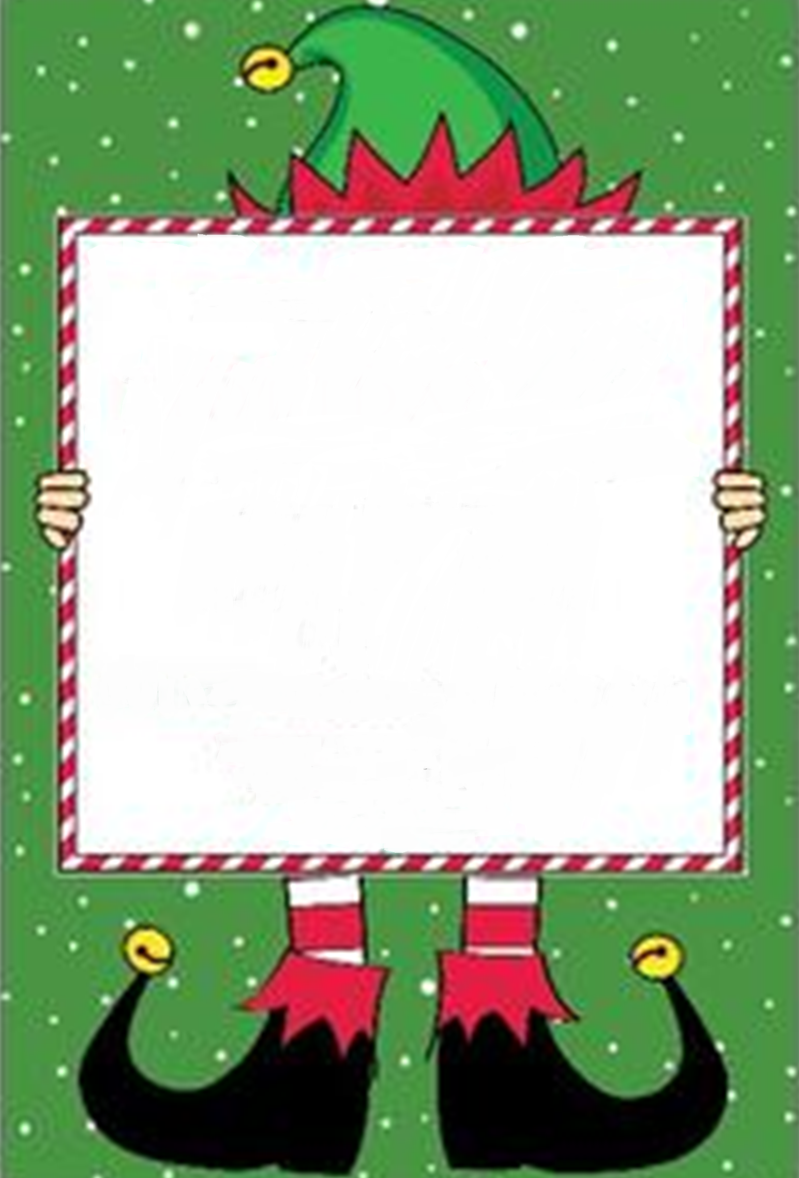
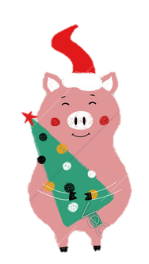
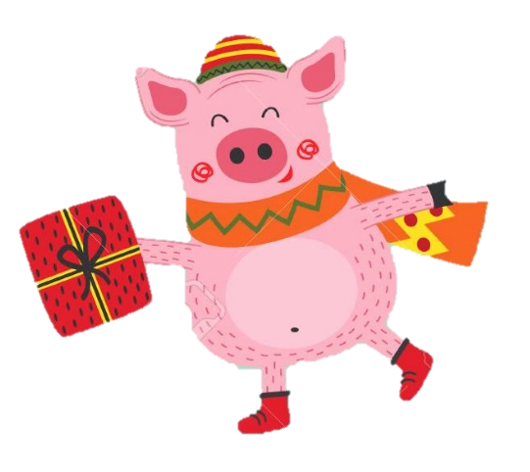
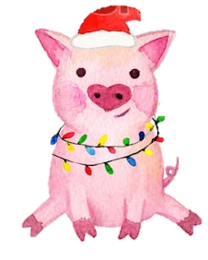
Little pigs Come to Andy’s Christmas party
Thursday
December 12th, 2019
3:30 – 4:30
Snacks, games, Christmas pictures, gift exchange (please bring a wrapped 5,000 won gift. (from Daiso or ArtBox,…etc…))
My address here

Slide 4
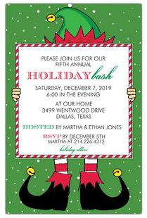
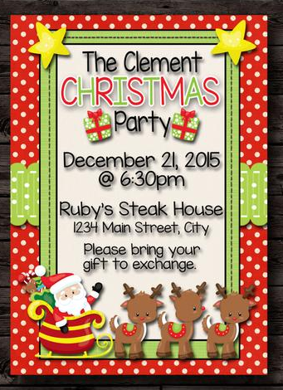


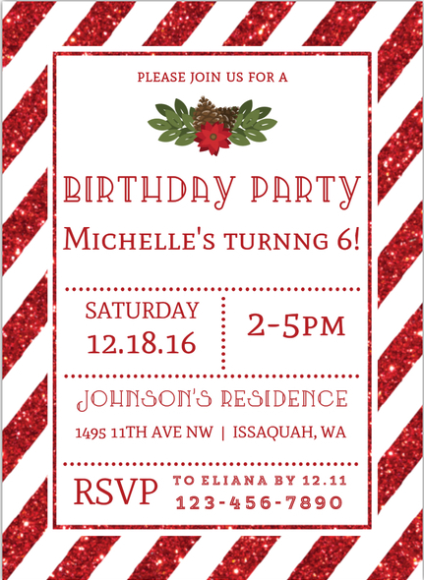
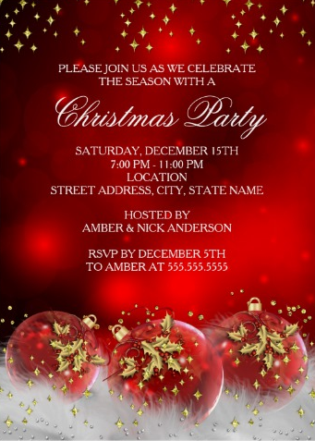

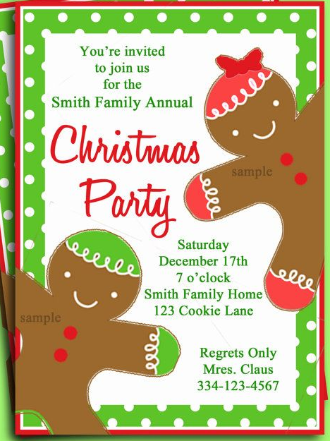
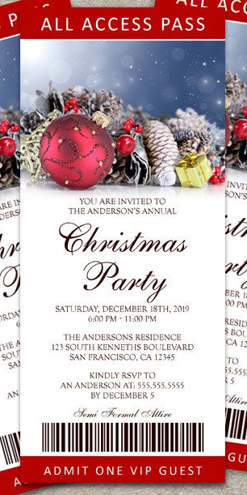
Christmas party invitation frames with potential for future use

Slide 5

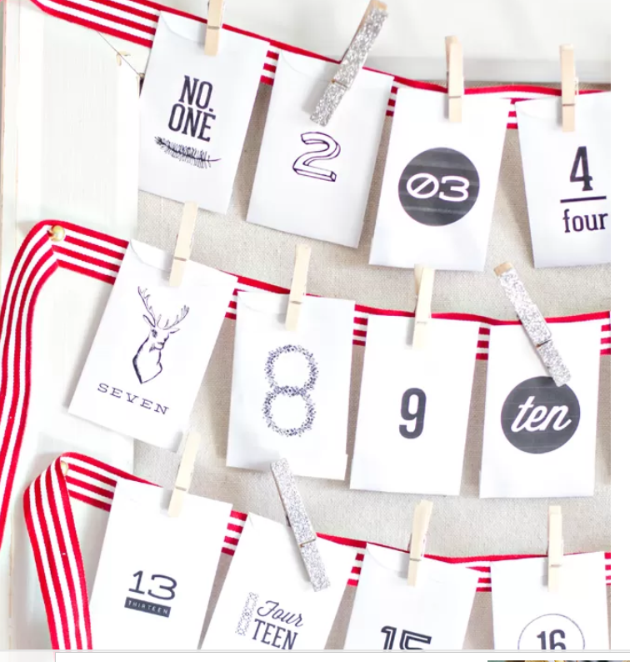

Here’s a website where you can download and print another version of activity cards, scripture cards, and paper envelopes for an advent calendar
https://www.yellowblissroad.com/diy-advent-calendar-with-activities-and-scripture/

Slide 6
A few of my favorite party games
Siamese gift wrap – teams of two. Players hug each other while attempting to wrap a present. They can only use one hand each. Each team will be provided with wrapping paper, scissors, tape, ribbon, and a box to wrap. First team to neatly wrap the present wins.
Unwrap the present with gloves - All players sit in a circle, person A is given winter gloves, a santa hat, and a ball of plastic wrap. He starts to unwrap it while wearing gloves to get to the present. Person B, on his right, is rolling 2 dice. When person B rolls a double, person A hands him the ball, hat and gloves. Person B gives the dice to person C, on his right. Person B starts to unwrap the vinyl ball while person C rolls the dice. There should be about 4 presents in the ball (host makes the ball by wrapping a gift in plastic wrap. Then adds another present onto the ball and wraps it again in plastic. Then adds another gift onto the ball…..etc.
Draw a Christmas picture – players are given a blank paper, a marker and a book. They are shown a Christmas / winter scene (the host can show them a printout or show it on a TV screen). The players places the paper on top of the book, and the book on top of their head, then draw the picture. Whoever draws the best picture wins.
Reindeer needs to poop – You need teams of 3. A Santa (with a Santa hat), a reindeer (with an antler headband, jingle bells necklace and a rope of some kind to go around his chest that Santa will hold onto as reins), and an elf (wearing a green hat or green elf jersey). Also a potato and a bucket or bowl…………………..Now, put the bucket on the other end of the room. Have the teams stand behind a marked line. Say “go” and the elf hands the antlers and jingle bells necklace to the reindeer and the hat and rope to Santa. After they’ve put on their gear, elf gives the potato to reindeer. Reindeer puts it between his thighs and walks/ runs to the bucket with Santa holding onto the reins and elf following Santa. If the potato falls before they reach the bucket, elf picks it up and hands it back to reindeer. When they get to the bucket, reindeer lets go of his load and drops it into the bucket (by opening his thighs). If he misses , elf picks it up and hands it back to him to do it again. If they succeed Elf picks up the potato from the bucket and they run back to give it to the next three teammates if there are more in the group.
Reindeer games – put antler headbands on 3 players and a reindeer tail between their pants and tucked-in shirt or through a belt loop. Most of the tail should be loosely hanging out. I made mine from brown felt (get 3 sheets of brown felt. Cut them lengthwise in fringes but stop about 2 inches from the end. Put hot glue along the length of the uncut side, roll up to make the tail). Play some upbeat music while the 3 reindeer try to steal each other’s tails. There should be boundaries that they can’t pass (no walls to back up to). The last reindeer left with a tail wins.

Slide 7
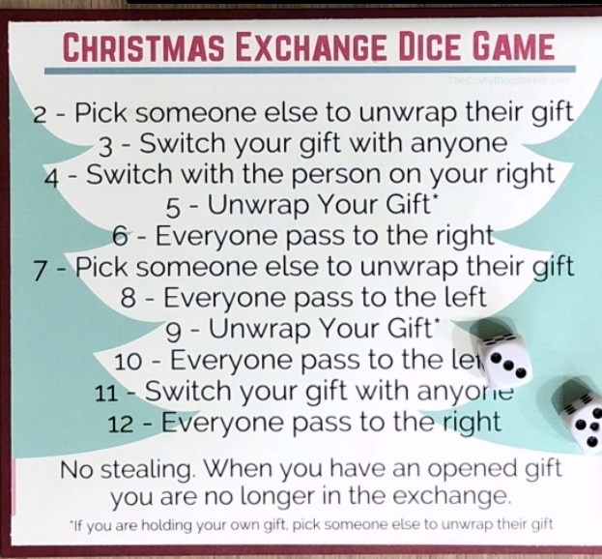
Christmas party gift exchange

Slide 8
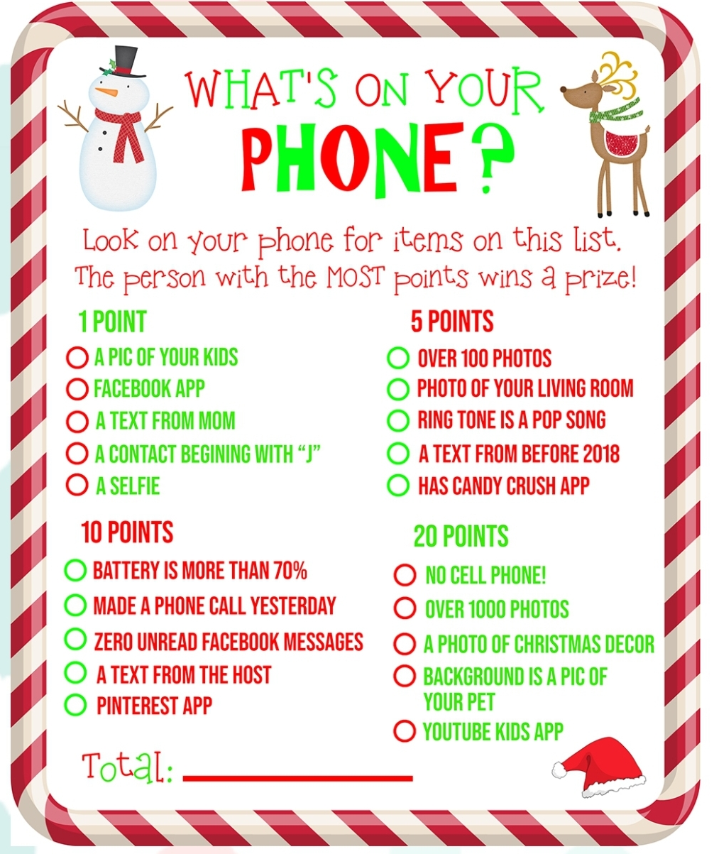
Christmas party games -
Christmas phone scavenger hunt

Slide 9
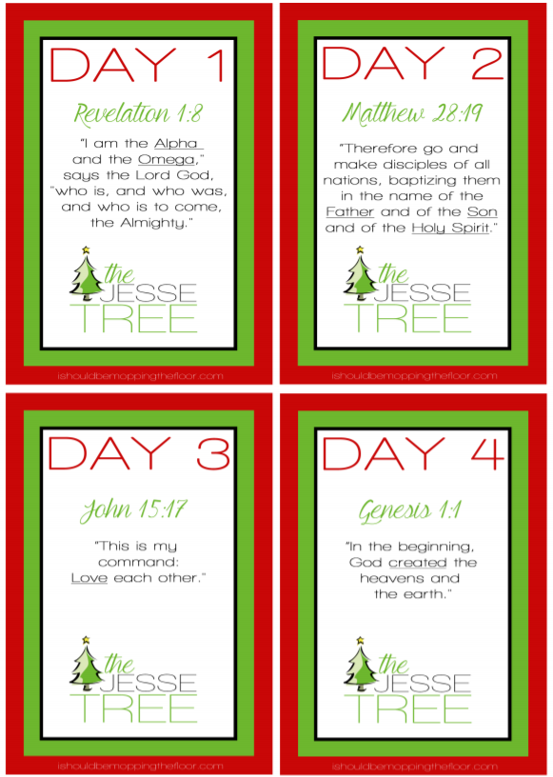
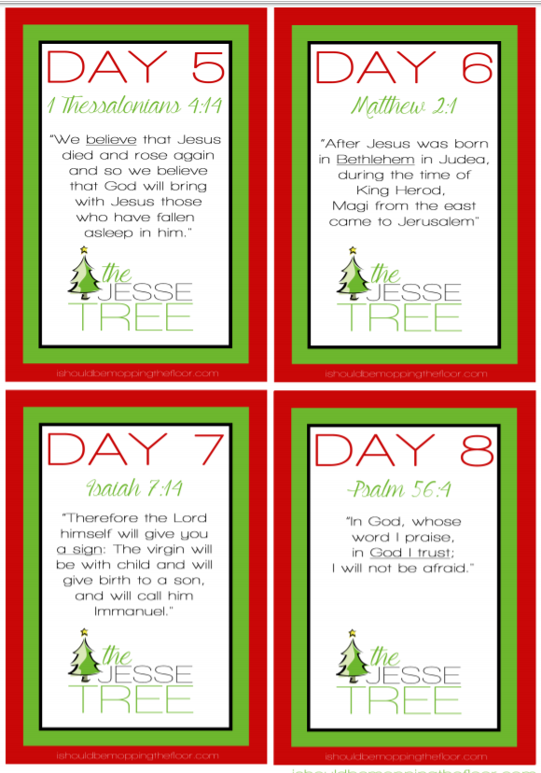
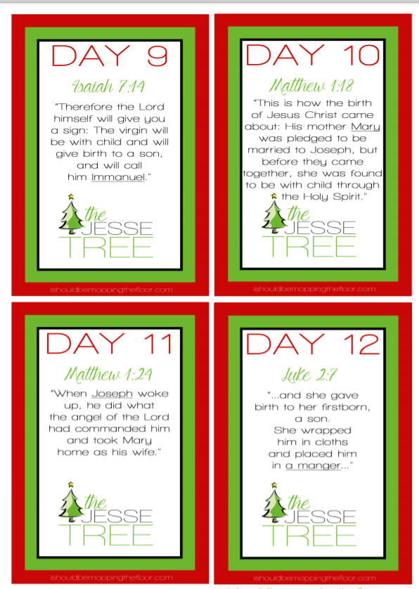
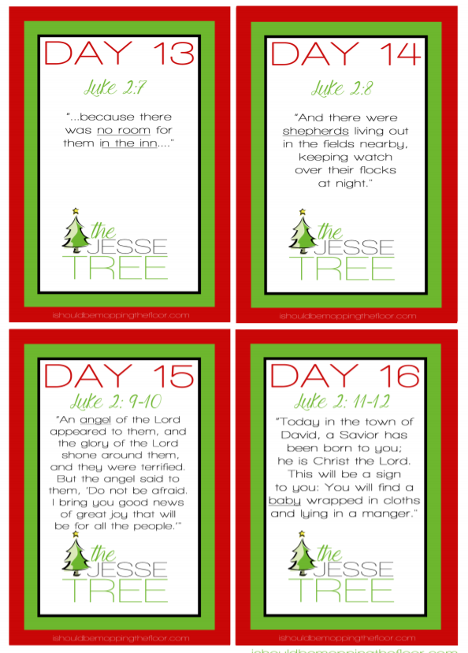
Advent calendar Bible verses

Slide 10
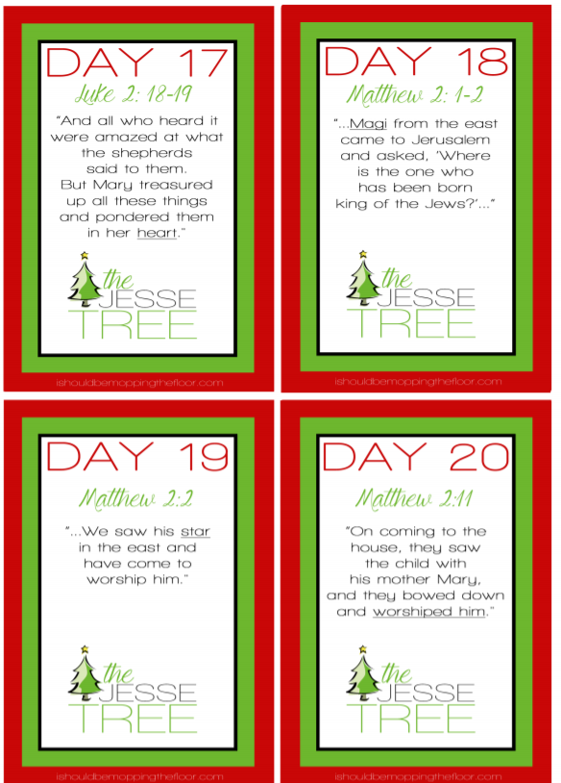
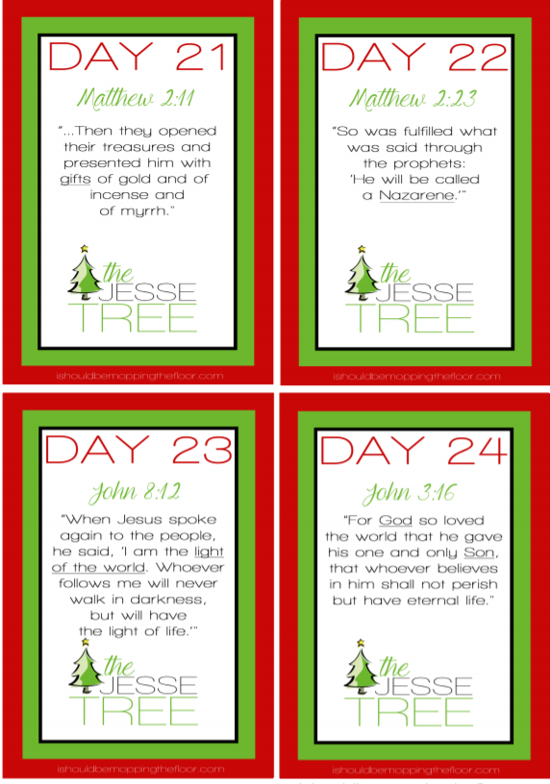

Slide 11
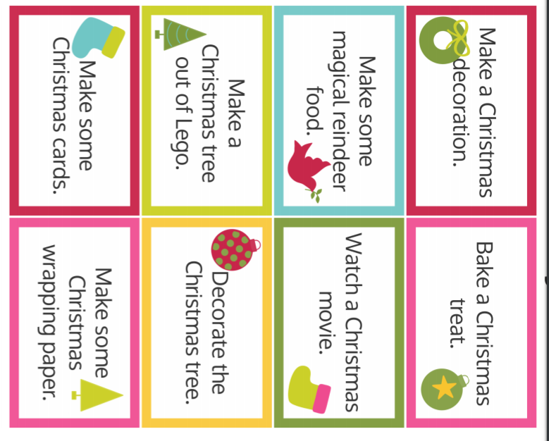
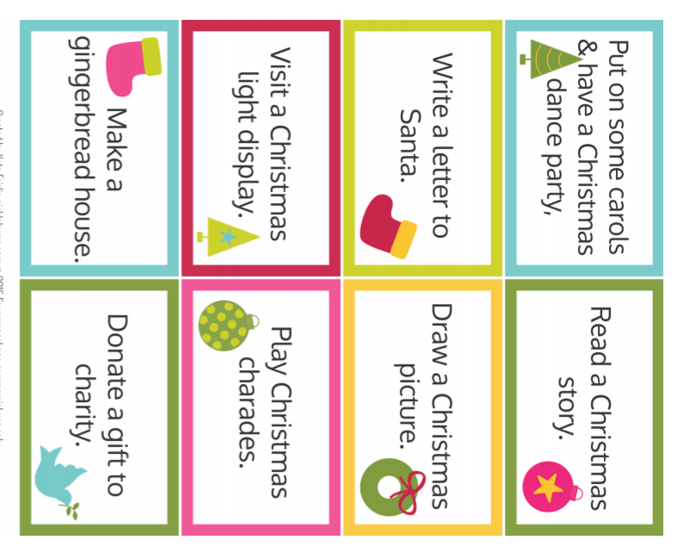
Advent calendar activity cards

Slide 12
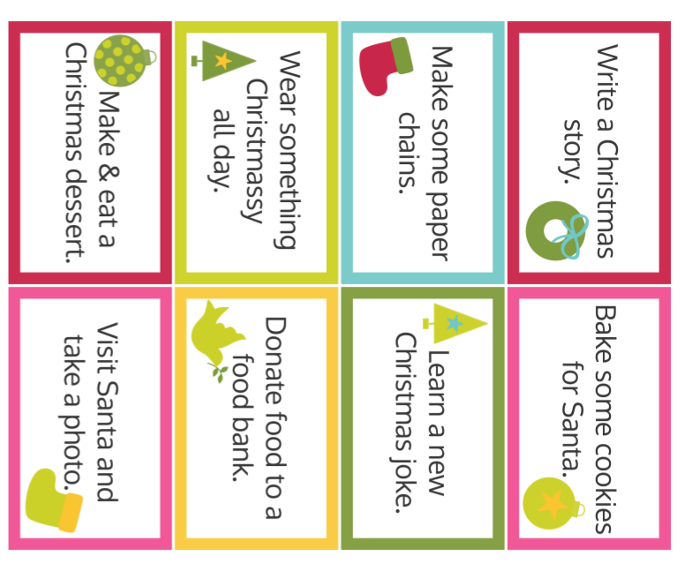
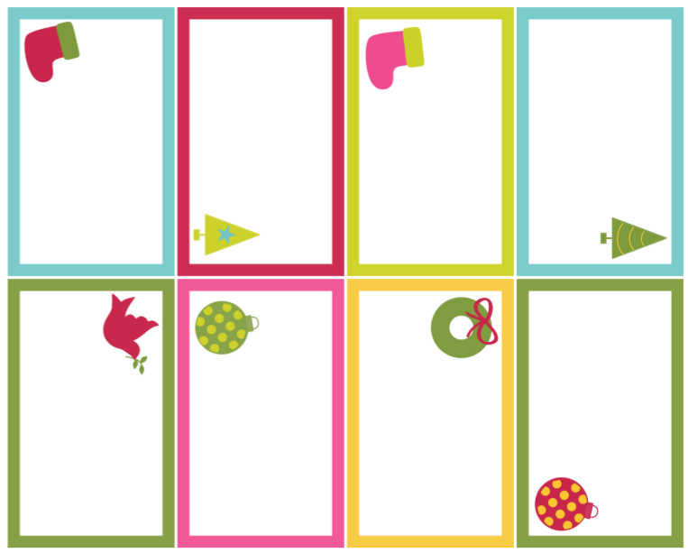
Advent calendar activity cards
Buy or make a Christmas cake
Plan or have a Christmas party
Put up the Christmas tree
Take a family Christmas portrait
Write Christmas cards
Bake cookies and give them to your grocer, security guard, neighbor….etc.
call relatives to say hi
Go Christmas shopping
Visit a Christmas festival

Slide 13
Buy or make a Christmas cake
Blank cards to write in your own activities

Slide 14
To:
From:
To:
From:
To:
From:
To:
From:
Gift name tags
To:
From:
To:
From:
To:
From:
To:
From:
To:
From:
To:
From:
To:
From:
To:
From:
To:
From:
To:
From:
To:
From:

